Slide 1
YT SENTIMENT EXPLORER
Presenting By:
Sai Preetham, Manjunath
Prasanna, Vinith

Slide 2
OUTLINE
Introduction
Existing Project
Proposed Project
Project Analysis
Design
Project Flow
Applications
Pros and Cons
Conclusion

Slide 3
INTRODUCTION
In the digital age, social media platforms generate vast amounts of user-generated content. YouTube, being one of the largest video-sharing platforms, hosts millions of videos with billions of comments.
Our project focuses on automated sentiment analysis of YouTube comments to classify them into Positive, Neutral, or Negative categories. By leveraging Natural Language Processing (NLP) techniques, this tool extracts and processes comments to provide a sentiment-based summary of a given video.

Slide 4
EXISTING PROJECT
The existing project for analysing YouTube comments are limited in functionality and efficiency. Moreover, it is constrained by the following issues:
Limited Comment Extraction
Lack of Scalability
Inability to Save Results
User Experience Constraints

Slide 5
PROPOSED PROJECT
The scope of this project is defined to ensure that it provides a comprehensive solution for fetching, analyzing, and reporting YouTube video comments. The In-Scope Features are,
YouTube Comment Extraction
Flexible Comment Limit
Data Storage
Sentiment Analysis

Slide 6
COMPARISON
Feature | Existing Project | Proposed Project
Comment Extraction | one video at a time | multiple videos
Max Comments Limit | 100 comments per video | thousands of comments
Scalability | Not scalable for large datasets | Scalable for large-scale sentiment analysis
Data Storage | No option to save comments | Exports data in CSV format for further analysis
Reporting & Insights | No detailed summary reports | Provides detailed sentiment distribution reports
User Experience | Lacks customization options | Users can define comment count and filename

Slide 7
User Interface (UI)
- Input video URL
- Input required comment
count and file name
- View analysis report
Comment Fetching Module
- YouTube Data API integration
- Fetch comments based on
user input
- Store comments temporarily
Data Processing Module
- Clean & preprocess fetched comments
- Prepare data for sentiment analysis
- Save processed data into CSV
Sentiment Anlysis Module
- Analyse comments using
Pre-built model
- Classify into Positive/
Negative/Neutral.
Reporting Module
- Generate Summary Results:
* SentimentDistributions
* Total Comments Analysed
* Accuracy
- Export Results to User
Data Storage Module
-Store comments in CSV file
- Save analysis results for
future access
Fig: High-Level Architecture

Slide 8
PROJECT ANALYSIS
System Analysis :
System analysis is a critical phase of project development that involves understanding the functional and non-functional requirements, limitations of existing solutions, and the enhancements introduced in the proposed system.
Hardware and Software Selection

Slide 9
Hardware Requirements
Component | Specification
Processor | Intel Core i3 or higher / AMD Ryzen 5 or higher
RAM | Minimum 8 GB (16 GB recommended for large datasets)
Storage | Minimum 250 GB SSD (500 GB recommended for better performance)
Graphics | Integrated graphics sufficient (dedicated GPU optional)
Network | Stable internet connection for accessing YouTube API

Slide 10
Software Requirements
Component | Details
Operating System | Windows 8,10/11, macOS
Programming Environment | Visual Studio Code (or any preferred IDE)
Programming Language | Python 3.9 or later
APIs | YouTube Data API v3 for fetching comments
Libraries and Frameworks | Required Python libraries: -googleapiclient for API integration - pandas for data manipulation - nltk for sentiment analysis matplotlib for data visualization - numpy for numerical computations
Browser | Google Chrome, Mozilla Firefox, or Microsoft Edge
Package Manager | pip (Python's package installer)

Slide 11
DESIGN
Data Design: The data design defines how the system organizes and stores data during the fetching, analysis, and reporting processes.
Input Data
Raw Data
Processed Data
Output Data

Slide 12
DATA DEFINITION
Input Fields
Output Fields
Field | Type | Description
Video URL | String | URL of the YouTube video
No. of Comments | Integer | Max. number of comments to fetch
File Name | String | Name of the CSV file to save comments
Field | Type | Description
Video URL | String | URL of the given YouTube Video
Sentiment | String | Sentiment label: Positive, Negative, Neutral

Slide 13
PROJECT FLOW
Flow of the YT Sentiment Explorer Project is as follows:
User Input
Extract Video URL
Fetch Comments
Perform Sentiment Analysis
5. Calculate Metrics
6. Save & Display Results
7. Download CSV File
8. Error Handling

Slide 14
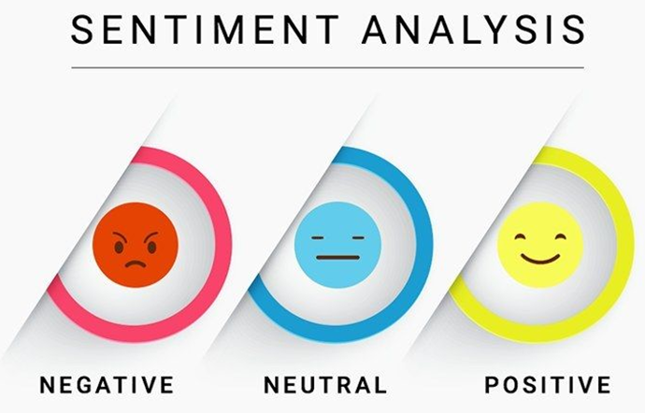
SENTIMENT ANALYSIS PROCESS
The sentiment analysis involves using natural language processing techniques to determine the sentiment of comments, categorizing them into positive, negative, or neutral.
This process offers deeper insights into audience perception and emotions.

Slide 15
Keyword analysis
In this project we use VADER (Valence Aware Dictionary and sEntiment Reasoner) is a rule-based sentiment analysis tool specifically designed for social media text, reviews, and comments.
VADER has a predefined sentiment lexicon, which assigns words predefined sentiment scores.

Slide 16
Lexicon-Based Sentiment Scoring
VADER uses a predefined dictionary of words with associated sentiment scores. Each word in the comment is assigned a score:
Positive words (e.g., "awesome", "love") → +ve score
Negative words (e.g., "terrible", "hate") → -ve score
Neutral words (e.g., "the", "video") → 0 score
Example:
"This video is amazing!"
"amazing" has a high positive score → Overall sentiment: Positive

Slide 17
VADER calculates a compound score between -1 (negative) to +1
(positive) based on the overall sentiment of the sentence.
Positive Sentiment → Compound score ≥ 0.05
Negative Sentiment → Compound score ≤ -0.05
Neutral Sentiment → Compound score between -0.05 and 0.05
Example:
"I love this video, it's fantastic!" → Positive (0.75)
"This video is not great, it's boring." → Negative (-0.55)
"This video is okay." → Neutral (0.0)

Slide 18
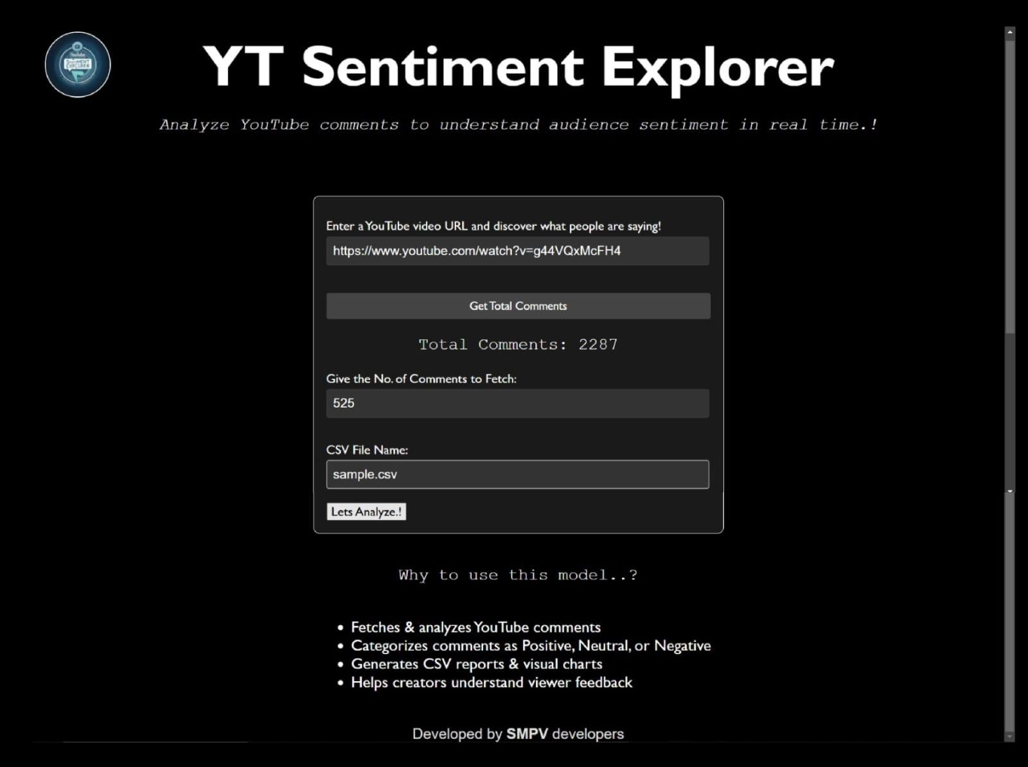


RESULTS
Input Page

Slide 19
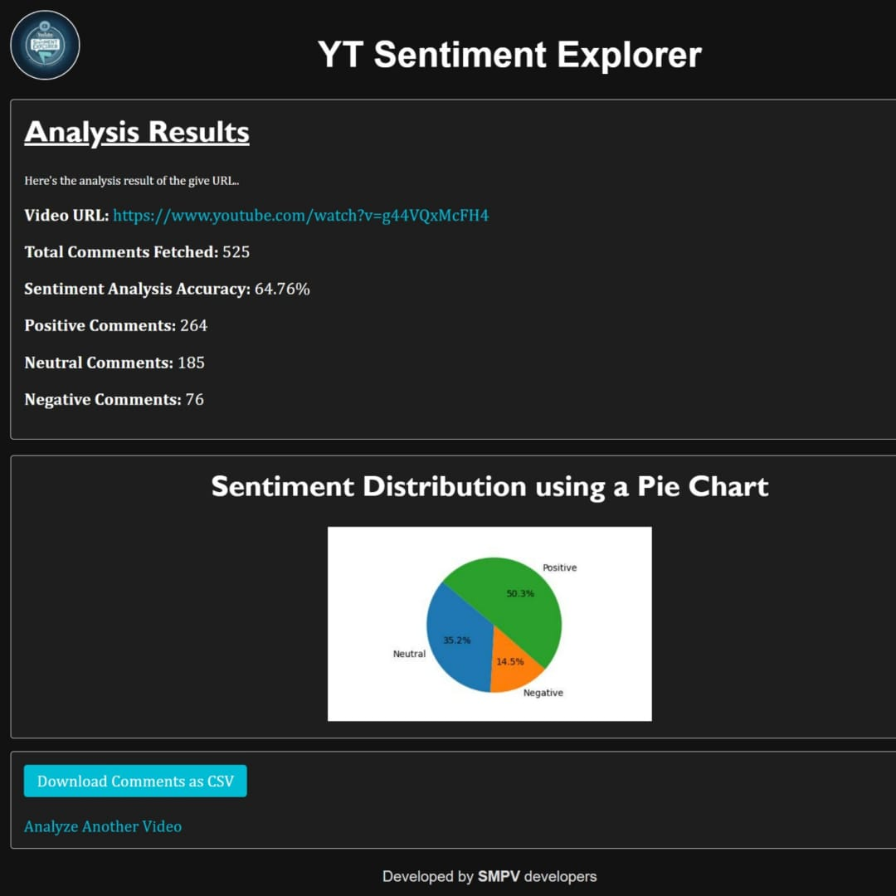
Output Page

Slide 20
applications
Content Creators & Influencers
Digital Marketing & Brand Analysis
Social Media Monitoring
Customer Feedback Analysis
Academic & Research Purposes

Slide 21
Pros and cons
Pro’s
Audience Feedback Analysis
Improved Content Strategy
Brand Monitoring
Data-Driven Decisions
Time Efficiency

Slide 22
Con’s
Accuracy Issues
Context Misunderstanding
Bias in Training Data
Overreliance on Automation
Language Limitations

Slide 23
Conclusion
In conclusion, the YT Sentiment Explorer provides actionable insights for content creators, marketers, and community managers to harness the power of audience sentiments, enhance user engagement, and shape effective strategies for YouTube content development and management. The future work outlined will further improve the accuracy and utility of the analysis, making it an indispensable tool for content creators.

Slide 24
Thank you

